Slide 1
MEMORY MANAGEMENT

Slide 2
In an ideal world…
The ideal world has memory that is
Very large
Very fast
Non-volatile (doesn’t go away when power is turned off)
The real world has memory that is:
Very large
Very fast
Affordable!
Pick any two…
Memory management goal: make the real world look as much like the ideal world as possible

Slide 3
Memory hierarchy
What is the memory hierarchy?
Different levels of memory
Some are small & fast
Others are large & slow
What levels are usually included?
Cache: small amount of fast, expensive memory
L1 (level 1) cache: usually on the CPU chip
L2 & L3 cache: off-chip, made of SRAM
Main memory: medium-speed, medium price memory (DRAM)
Disk: many gigabytes of slow, cheap, non-volatile storage
Memory manager handles the memory hierarchy

Slide 4
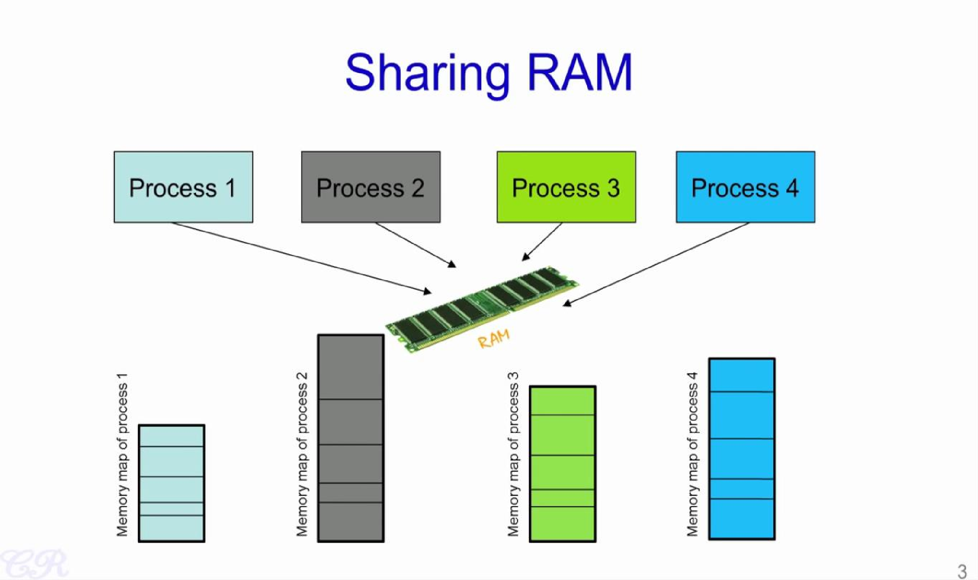

Slide 5
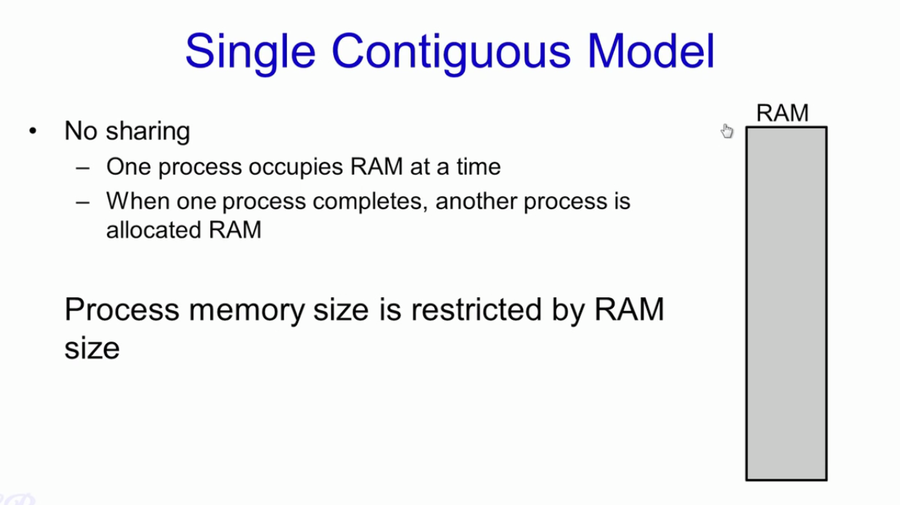

Slide 6
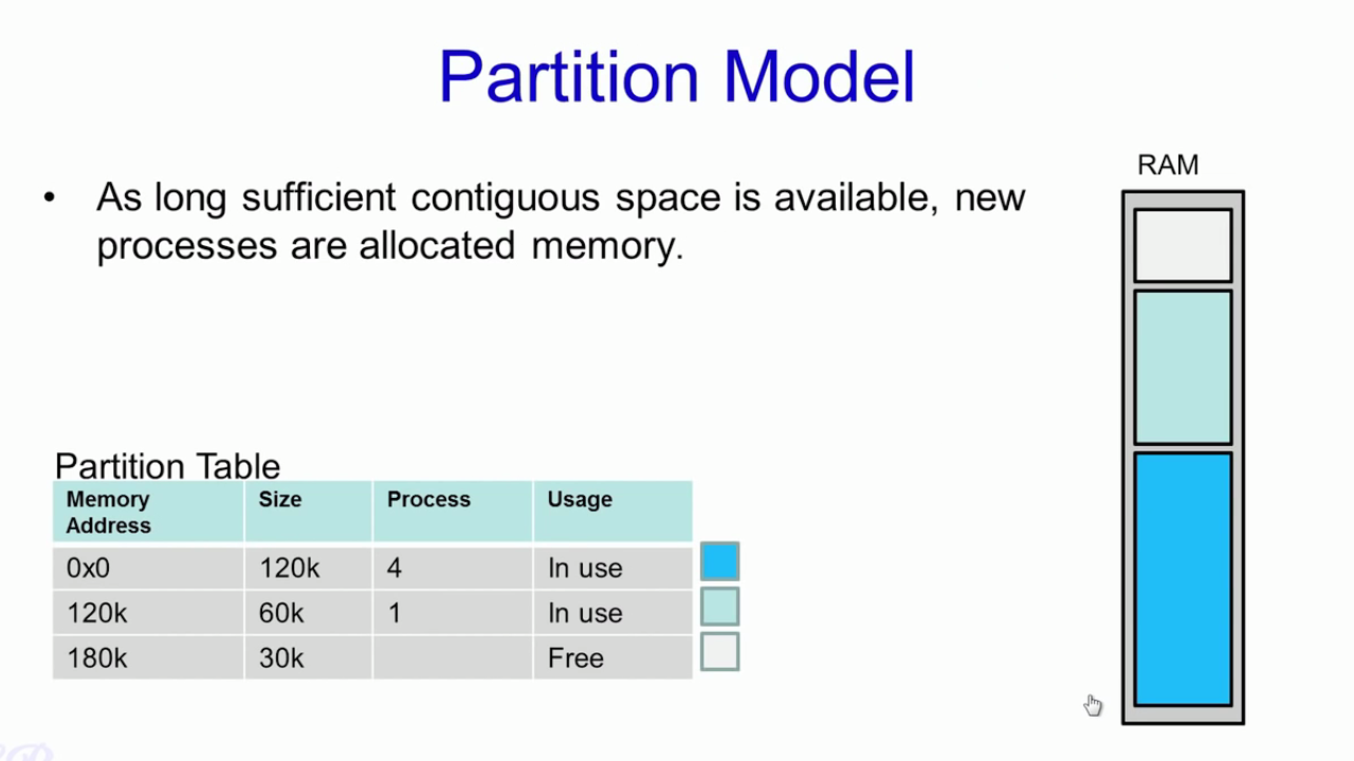

Slide 7
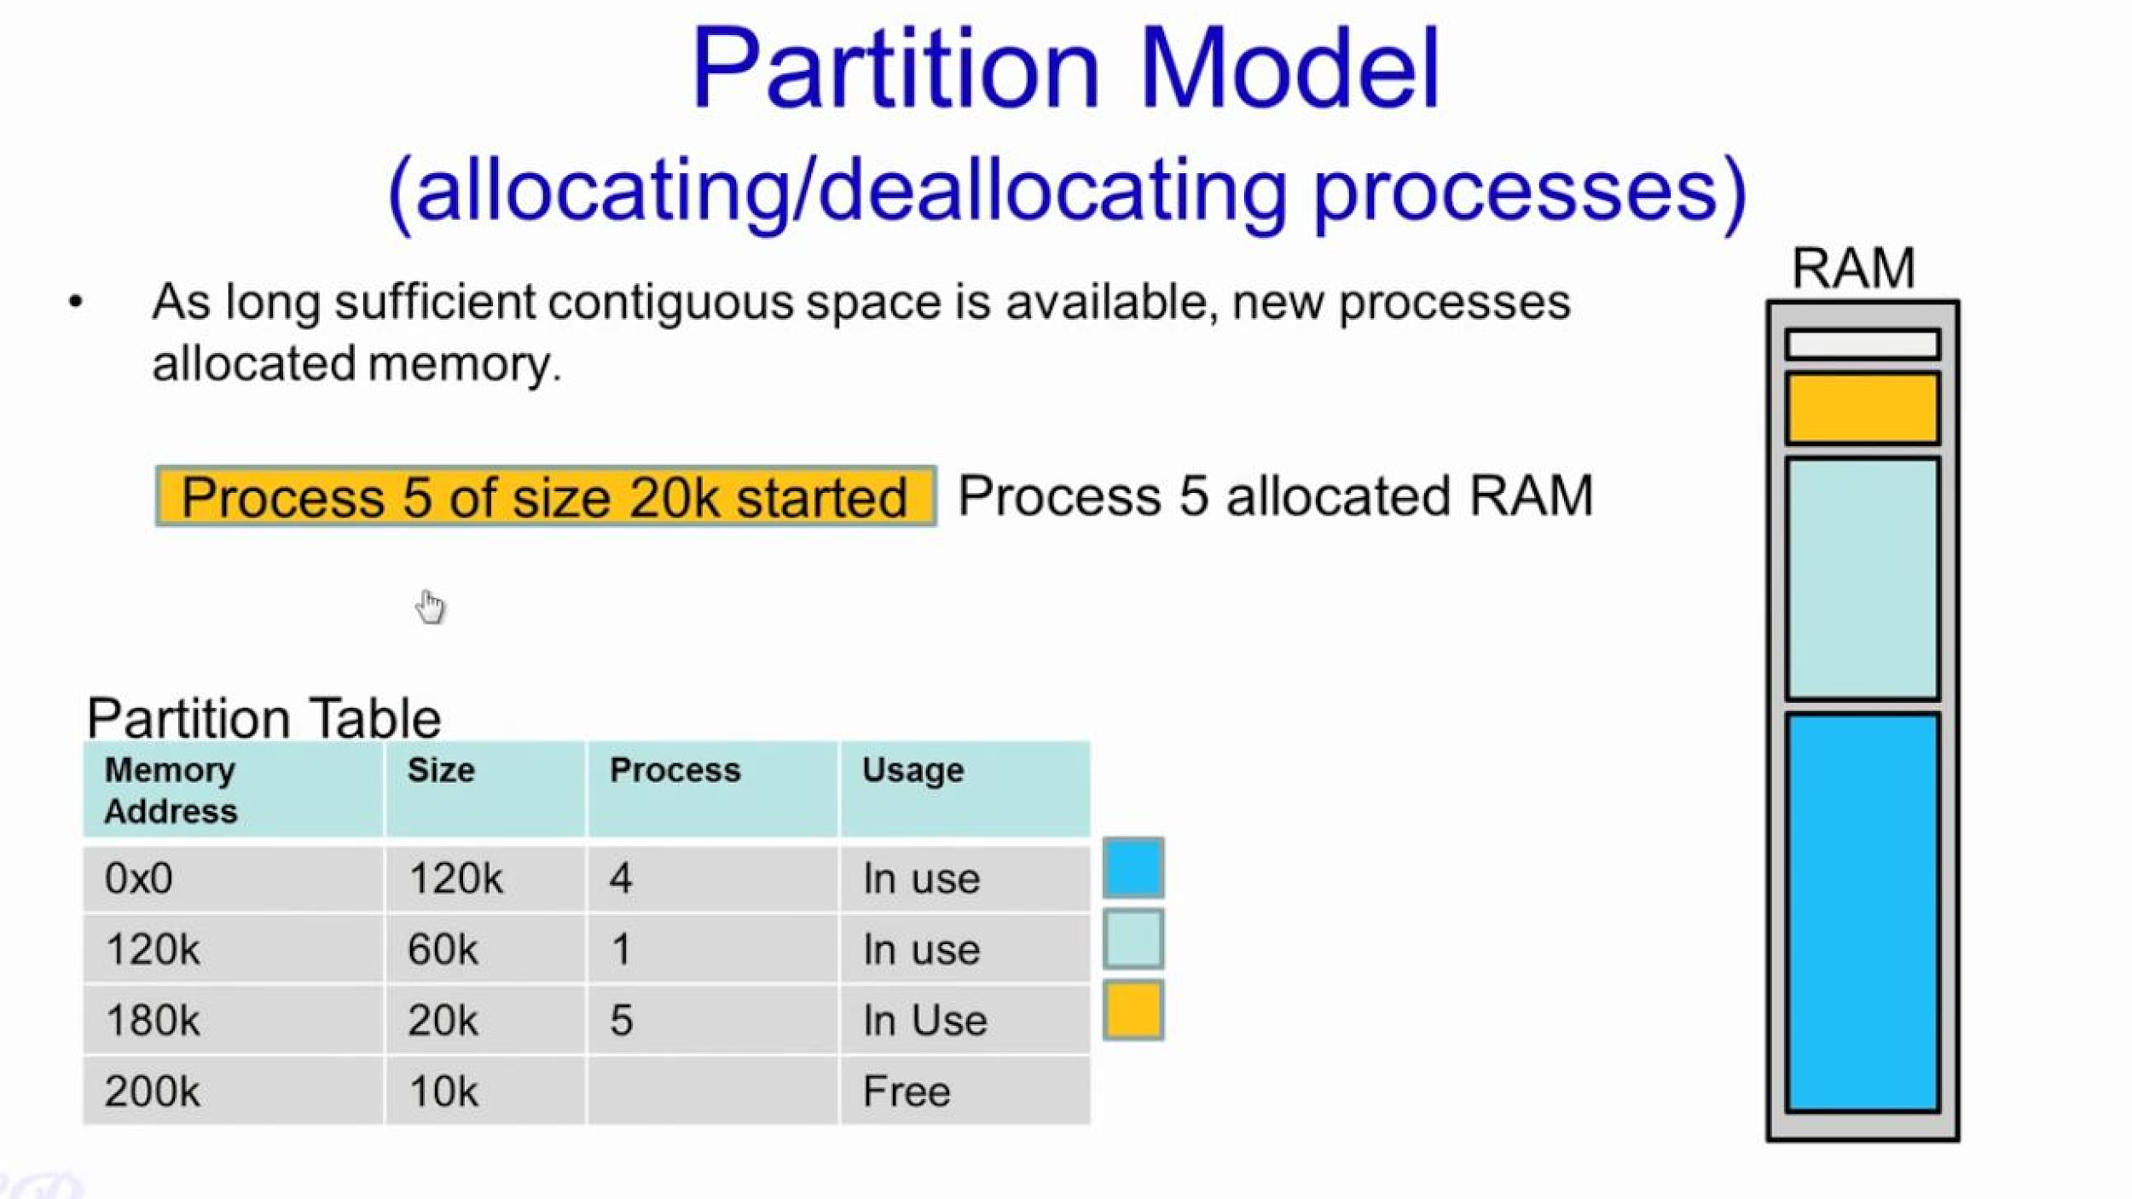

Slide 8
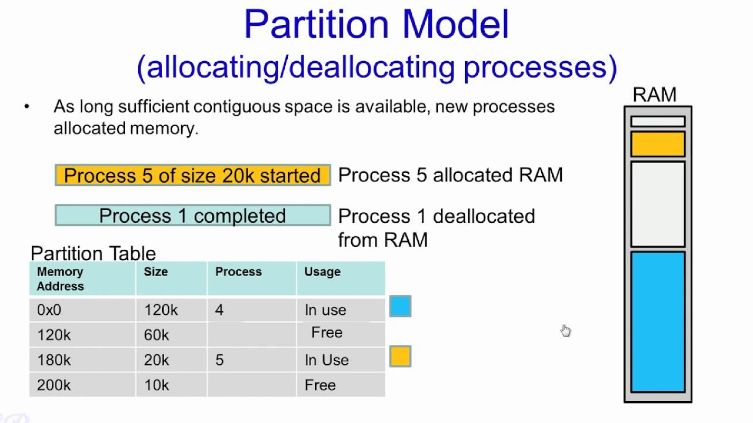

Slide 9
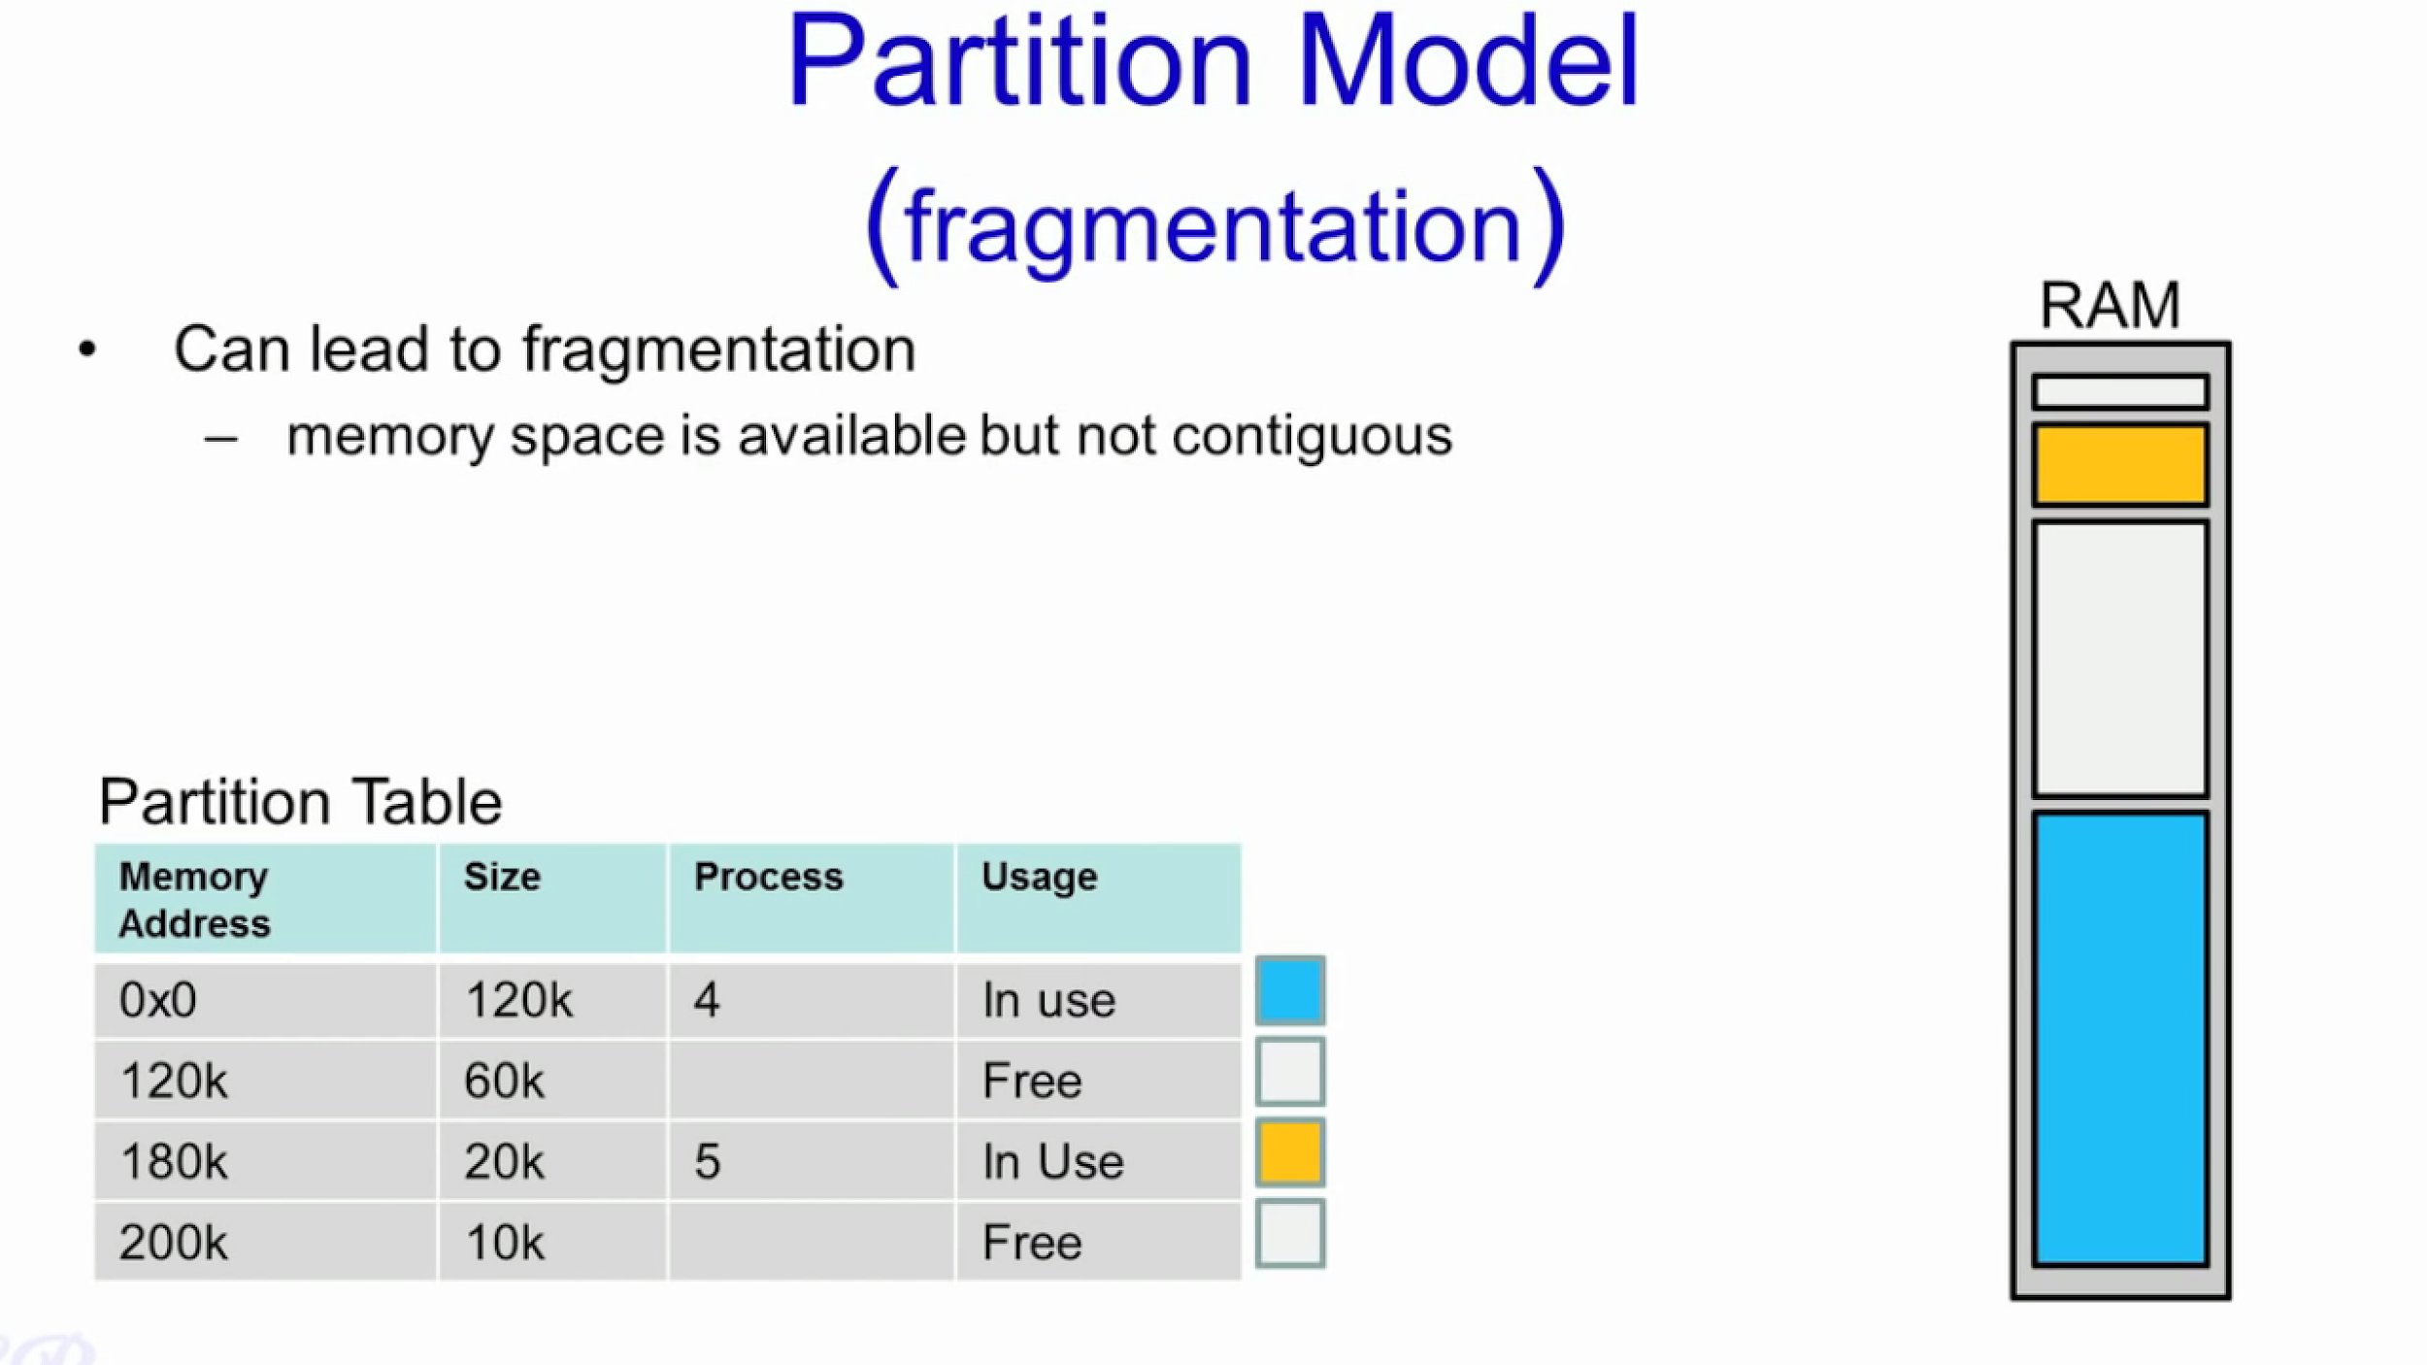

Slide 10
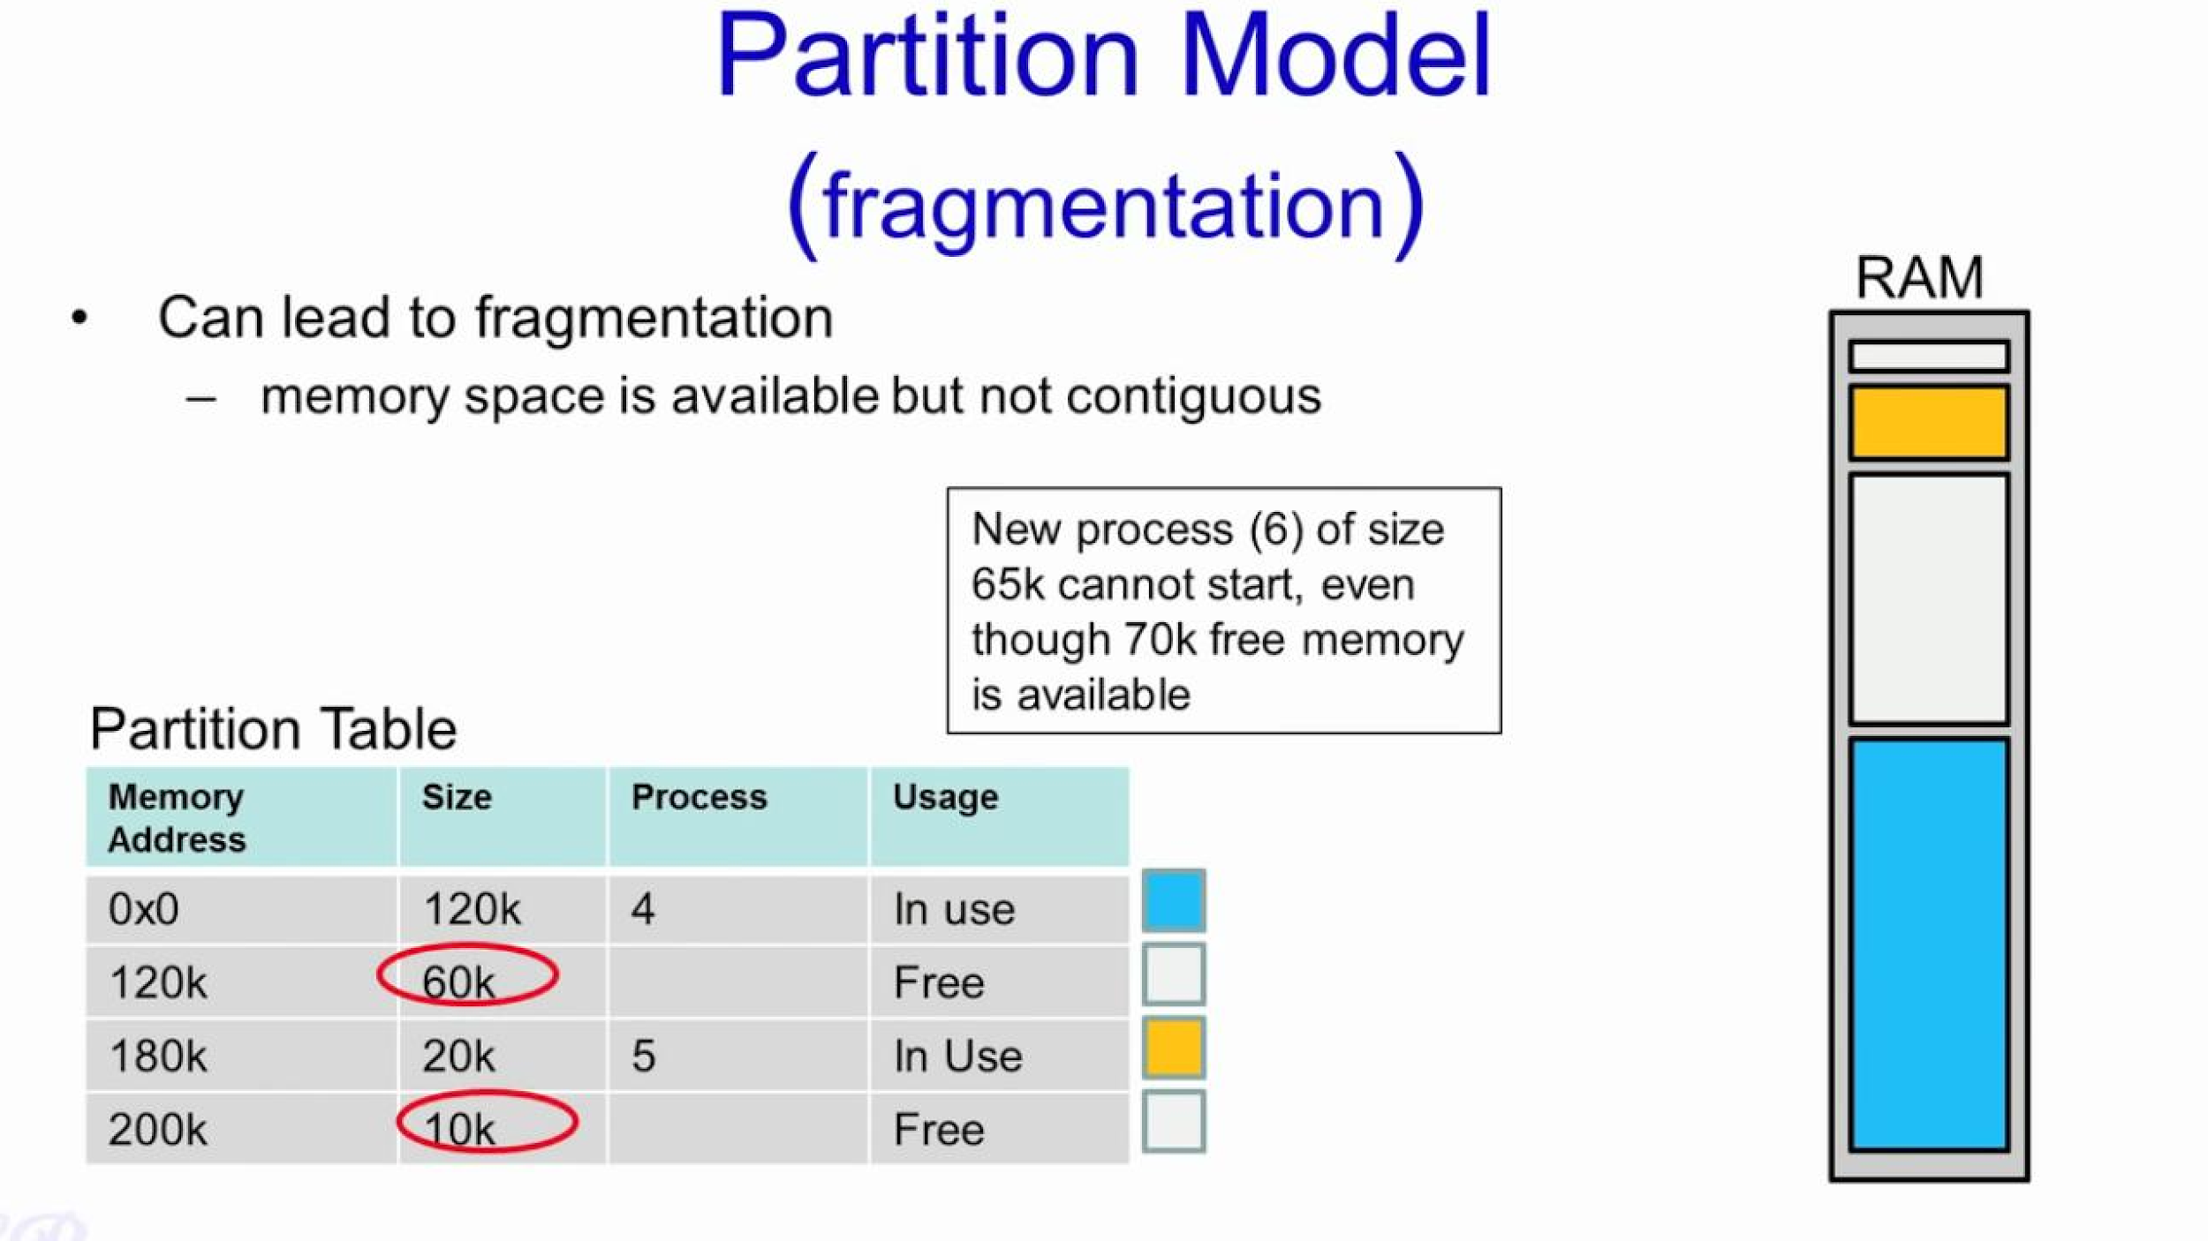

Slide 11
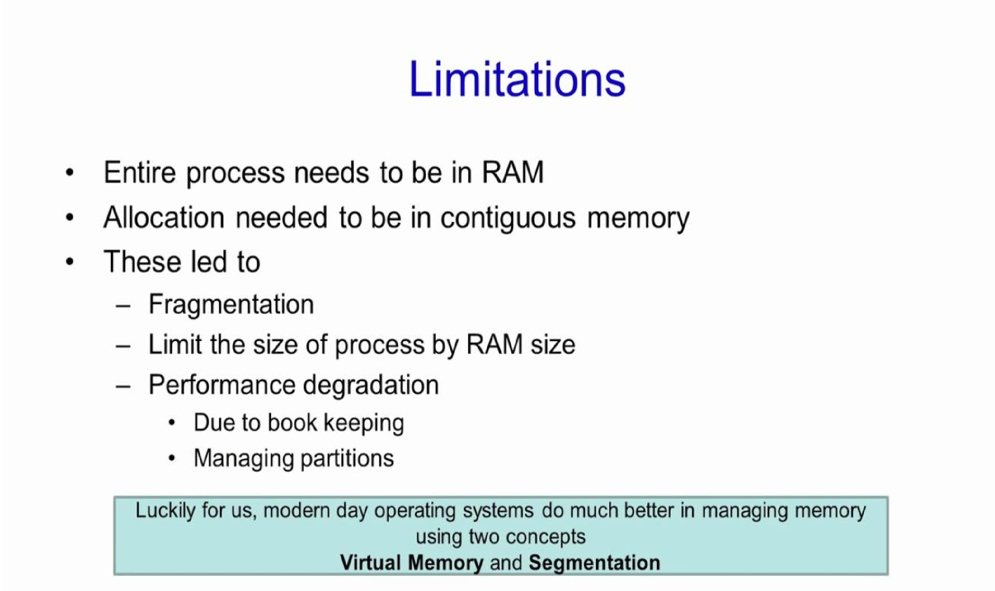

Slide 12
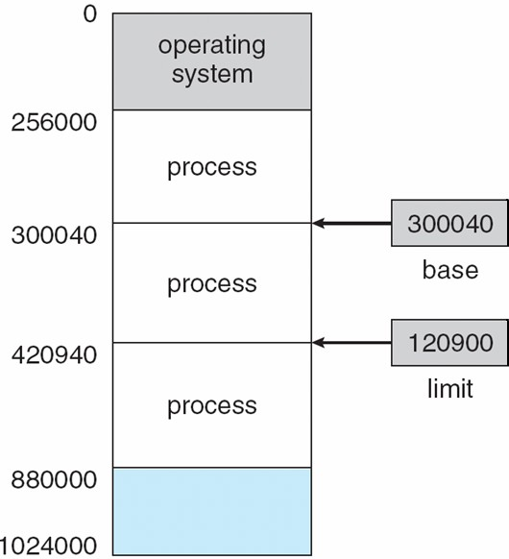
Base and Limit Registers
A pair of base and limit registers define the logical address space
CPU must check every memory access generated in user mode to be sure it is between base and limit for that user

Slide 13






Hardware Address Protection

Slide 14
Contiguous Allocation
Main memory must support both OS and user processes
Limited resource, must allocate efficiently
Contiguous allocation is one early method
Main memory usually into two partitions:
Resident operating system, usually held in low memory
User processes then held in high memory
Each process contained in single contiguous section of memory

Slide 15
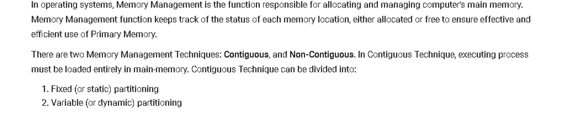

Slide 16
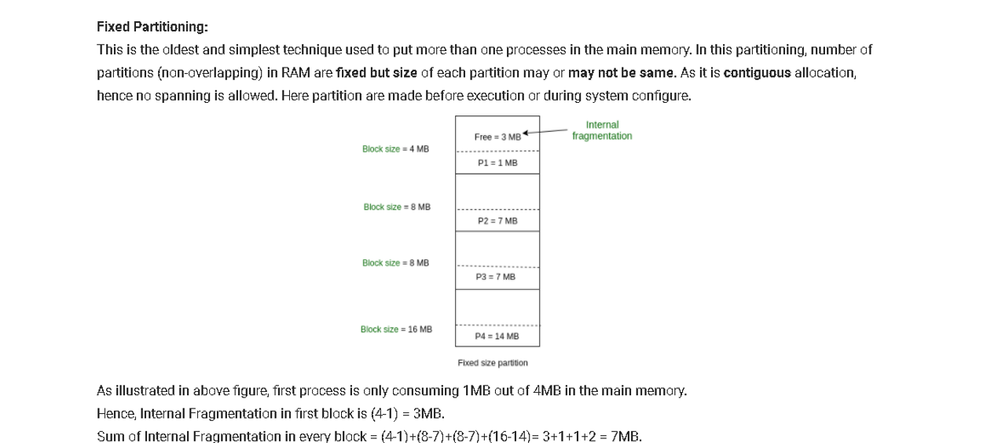

Slide 17
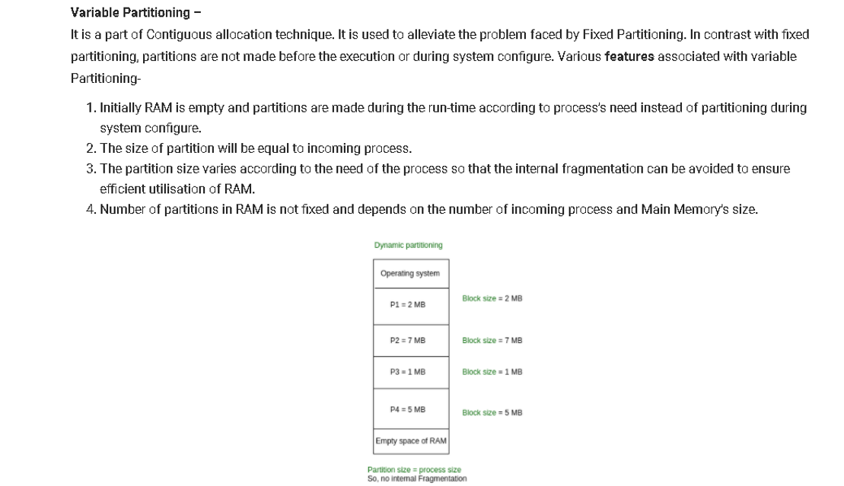

Slide 18
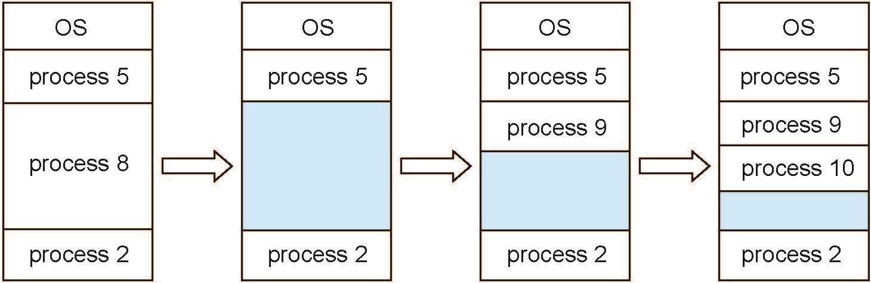
Multiple-partition allocation
Multiple-partition allocation
Degree of multiprogramming limited by number of partitions
Variable-partition sizes for efficiency (sized to a given process’ needs)
Hole – block of available memory; holes of various size are scattered throughout memory
When a process arrives, it is allocated memory from a hole large enough to accommodate it
Process exiting frees its partition, adjacent free partitions combined
Operating system maintains information about:
allocated partitions b) free partitions (hole)

Slide 19
Dynamic Storage-Allocation Problem
How to satisfy a request of size n from a list of free holes?
First-fit: Allocate the first hole that is big enough
Best-fit: Allocate the smallest hole that is big enough; must search entire list, unless ordered by size
Produces the smallest leftover hole
Worst-fit: Allocate the largest hole; must also search entire list
Produces the largest leftover hole
First-fit and best-fit better than worst-fit in terms of speed and storage utilization

Slide 20
Fragmentation
External Fragmentation – total memory space exists to satisfy a request, but it is not contiguous
Internal Fragmentation – allocated memory may be slightly larger than requested memory; this size difference is memory internal to a partition, but not being used

Slide 21
Fragmentation (Cont.)
Reduce external fragmentation by compaction
Shuffle memory contents to place all free memory together in
one large block

Slide 22
Various partition allocation schemes
First Fit: In the first fit, partition is allocated which is first sufficient from the top of Main Memory.
Best Fit Allocate the process to the partition which is first smallest sufficient partition among the free available partition.
Worst Fit Allocate the process to the partition which is largest sufficient among the freely available partitions available in the main memory.

Slide 23
Consider 6 memory partitions of sizes 200 KB, 400 KB, 600 KB, 500 KB, 300 KB and 250 KB, where KB refers to kilobyte. These partitions need to be allotted to four processes of sizes 357 KB, 210 KB, 468 KB, 491 KB in that order. If the best fit algorithm is used, which partitions are NOT allotted to any process?
200 KB and 300 KB
200 KB and 250 KB
250 KB and 300 KB
300 KB and 400 KB
four process
357 KB 210 KB 468 KB 491 KB (in order)
Memory partitions
200kb | 400kb | 600kb | 500kb | 300kb | 250kb
 | 357kb
 | 43kb

Slide 24
Consider 6 memory partitions of sizes 200 KB, 400 KB, 600 KB, 500 KB, 300 KB and 250 KB, where KB refers to kilobyte. These partitions need to be allotted to four processes of sizes 357 KB, 210 KB, 468 KB, 491 KB in that order. If the best fit algorithm is used, which partitions are NOT allotted to any process?
200 KB and 300 KB
200 KB and 250 KB
250 KB and 300 KB
300 KB and 400 KB
four process
357 KB 210 KB 468 KB 491 KB (in order)
Memory partitions
200kb | 400kb | 600kb | 500kb | 300kb | 250kb
 | 357kb |  |  |  | 210kb
 | 43kb |  |  |  | 40kb

Slide 25
Consider 6 memory partitions of sizes 200 KB, 400 KB, 600 KB, 500 KB, 300 KB and 250 KB, where KB refers to kilobyte. These partitions need to be allotted to four processes of sizes 357 KB, 210 KB, 468 KB, 491 KB in that order. If the best fit algorithm is used, which partitions are NOT allotted to any process?
200 KB and 300 KB
200 KB and 250 KB
250 KB and 300 KB
300 KB and 400 KB
four process
357 KB 210 KB 468 KB 491 KB (in order)
Memory partitions
200kb | 400kb | 600kb | 500kb | 300kb | 250kb
 | 357kb |  | 468kb |  | 210kb
 | 43kb |  | 32kb |  | 40kb

Slide 26
Consider 6 memory partitions of sizes 200 KB, 400 KB, 600 KB, 500 KB, 300 KB and 250 KB, where KB refers to kilobyte. These partitions need to be allotted to four processes of sizes 357 KB, 210 KB, 468 KB, 491 KB in that order. If the best fit algorithm is used, which partitions are NOT allotted to any process?
200 KB and 300 KB
200 KB and 250 KB
250 KB and 300 KB
300 KB and 400 KB
four process
357 KB 210 KB 468 KB 491 KB (in order)
Memory partitions
200kb | 400kb | 600kb | 500kb | 300kb | 250kb
 | 357kb | 491kb | 468kb |  | 210kb
 | 43kb | 119kb | 32kb |  | 40kb

Slide 27
Exercise on Allocation Strategy
Discuss partition selection algorithm in brief. Give memory partition of 150k, 550k, 250k, 350k & 650k (in order), how would each of the first fit, best fit and worst fit algorithm place the processes of 220k, 420k, 120k & 430k (in order). Which algorithm makes the most efficient use of memory?(variable size partitioning)
Memory partition
150kb | 550kb | 250kb | 350kb | 650kb
process
220kb
420kb
120kb
430kb

Slide 28
220kb
420kb
120kb
430kb
150kb | 550kb | 250kb | 350kb | 650kb
 | 220kb
 | 330kb
First Fit

Slide 29
220kb
420kb
120kb
430kb
150kb | 550kb | 250kb | 350kb | 650kb
 | 220kb |  |  | 420kb
 | 330kb |  |  | 230kb
First Fit

Slide 30
Can’t loaded
220kb
420kb
120kb
430kb
150kb | 550kb | 250kb | 350kb | 650kb
120kb | 220kb |  |  | 420kb
30kb | 330kb |  |  | 230kb
First Fit

Slide 31
220kb
420kb
120kb
430kb
150kb | 550kb | 250kb | 350kb | 650kb
 |  | 220kb
 |  | 30kb
Best Fit

Slide 32
220kb
420kb
120kb
430kb
150kb | 550kb | 250kb | 350kb | 650kb
 | 420kb | 220kb
 | 130kb | 30kb
Best Fit

Slide 33
220kb
420kb
120kb
430kb
150kb | 550kb | 250kb | 350kb | 650kb
 | 420kb | 220kb
 | 130kb | 30kb
 | 120kb
 | 10kb
Best Fit

Slide 34
220kb
420kb
120kb
430kb
150kb | 550kb | 250kb | 350kb | 650kb
 | 420kb | 220kb |  | 430kb
 | 130kb | 30kb |  | 220kb
 | 120kb
 | 10kb
Best Fit
All
allocated

Slide 35
220kb
420kb
120kb
430kb
150kb | 550kb | 250kb | 350kb | 650kb
Worst Fit

Slide 36
220kb
420kb
120kb
430kb
150kb | 550kb | 250kb | 350kb | 650kb
 |  |  |  | 220kb
 |  |  |  | 430kb
Worst Fit

Slide 37
220kb
420kb
120kb
430kb
150kb | 550kb | 250kb | 350kb | 650kb
 | 420kb |  |  | 220kb
 | 130kb |  |  | 430kb
Worst Fit

Slide 38
Can’t loaded
220kb
420kb
120kb
430kb
150kb | 550kb | 250kb | 350kb | 650kb
 | 420kb |  |  | 220kb
 | 130kb |  |  | 430kb
 |  |  |  | 120kb
 |  |  |  | 310kb
Worst Fit
Most efficient use of memory is BEST FIT

Slide 39
Consider six memory partitions of size 200 KB, 400 KB, 600 KB, 500 KB, 300 KB and 250 KB. These partitions need to be allocated to four processes of sizes 357 KB, 210 KB, 468 KB and 491 KB in that order.
Perform the allocation of processes using-
First Fit Algorithm
Best Fit Algorithm
Worst Fit Algorithm
https://www.gatevidyalay.com/tag/memory-management-in-os/

Slide 40
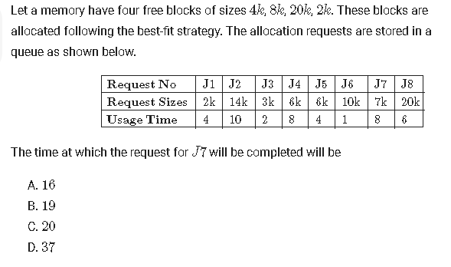

Slide 41
